Slide 1
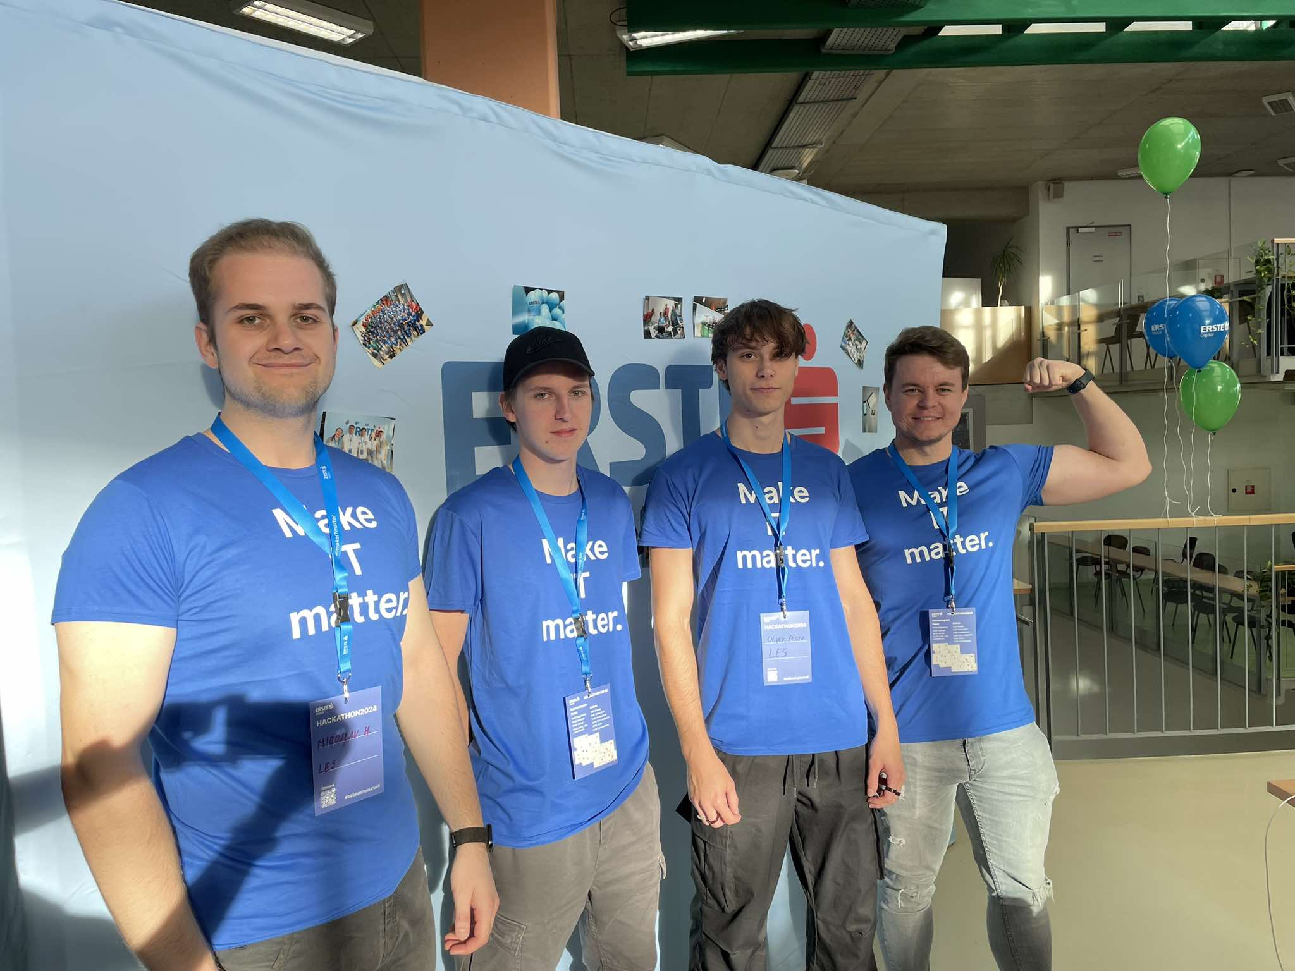
TEAM LES
MY AI VERSION

Slide 2
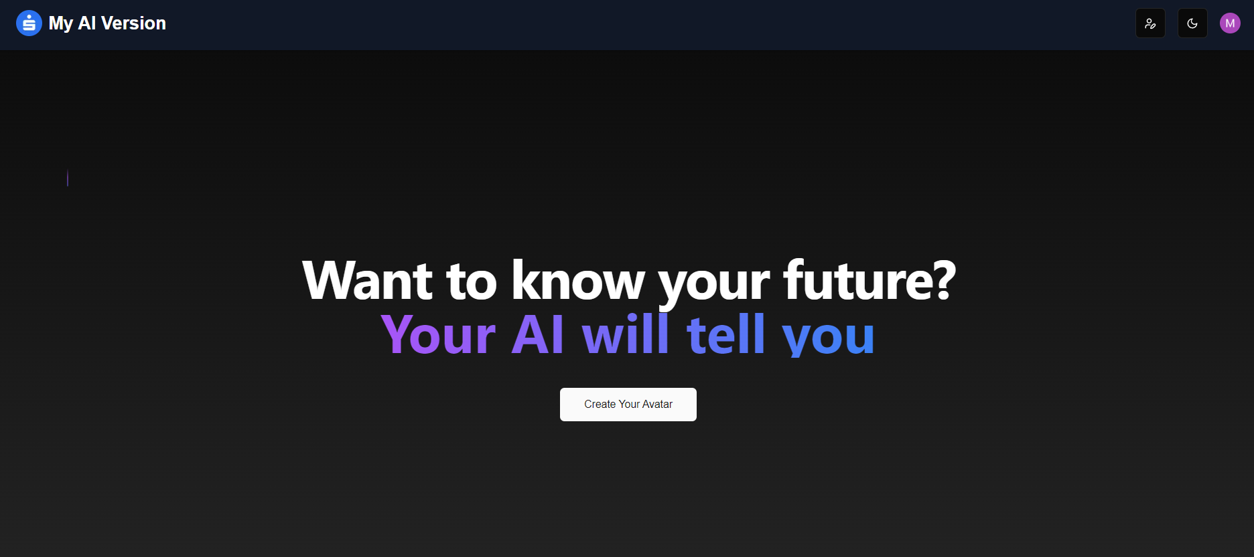
What was our goal?
Creation of our future self as AI assistant
Implement modern frameworks in the solution
To help people in difficult times

Slide 3




Technologies used

Slide 4
AI assistant Introduction
Avatar customization
Light/Dark mode
Giving tips for your future
Financial help
Relationship tips
Long-term advices
Education assistance

Slide 5
How does it work?

Slide 6
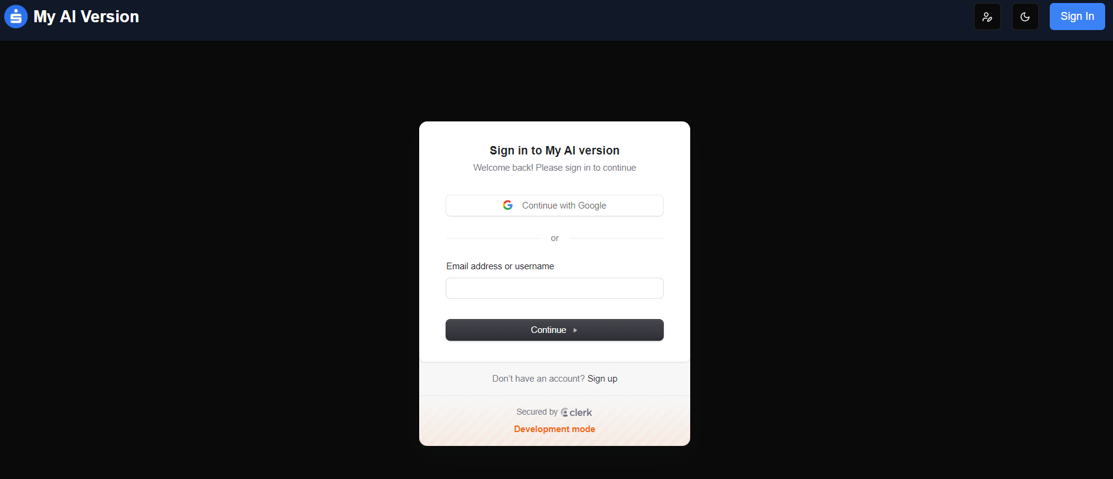
Sign in with Clerk!

Slide 7
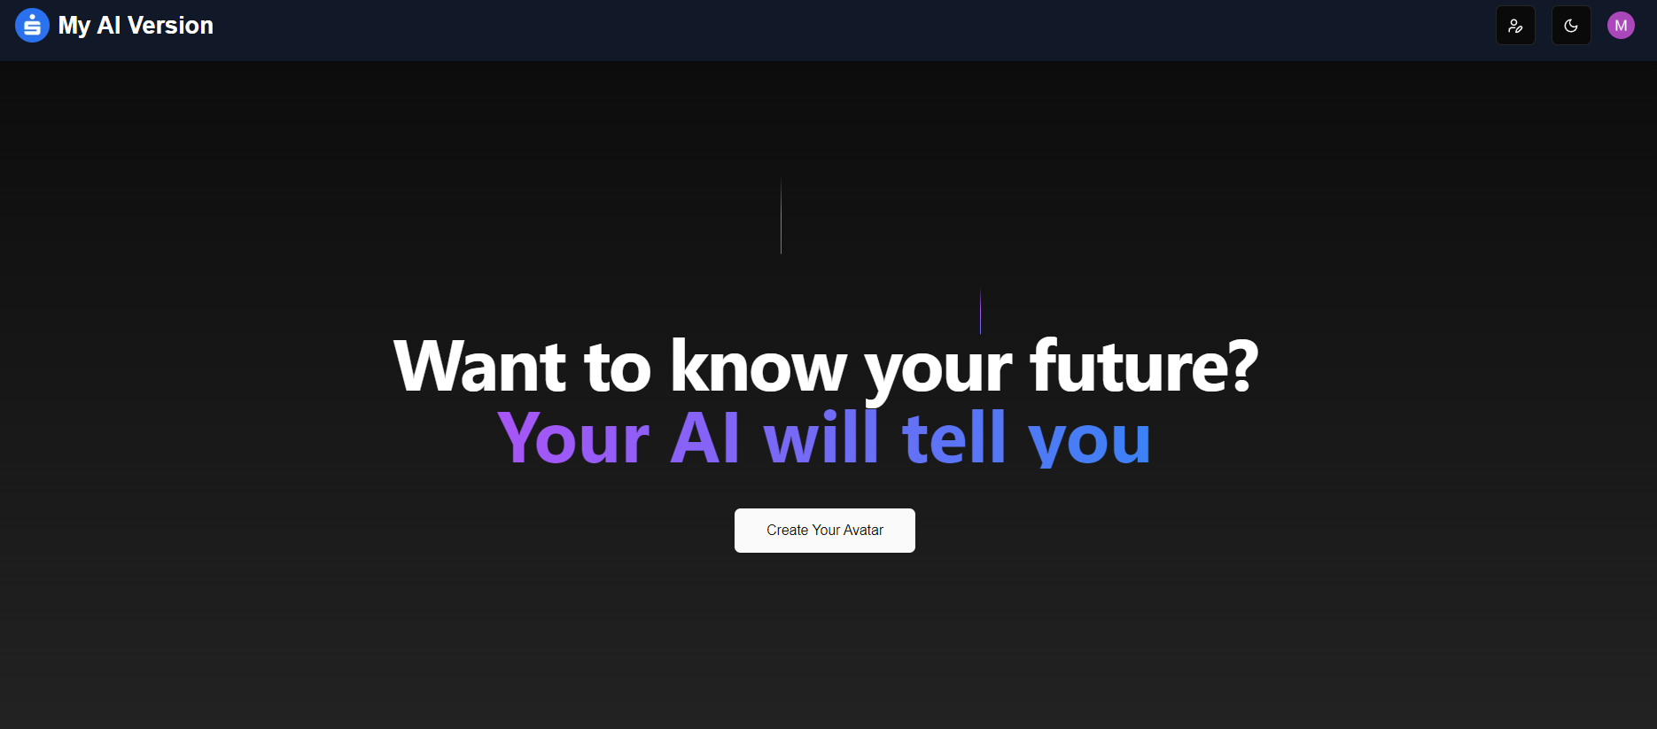
There goes the main page!

Slide 8
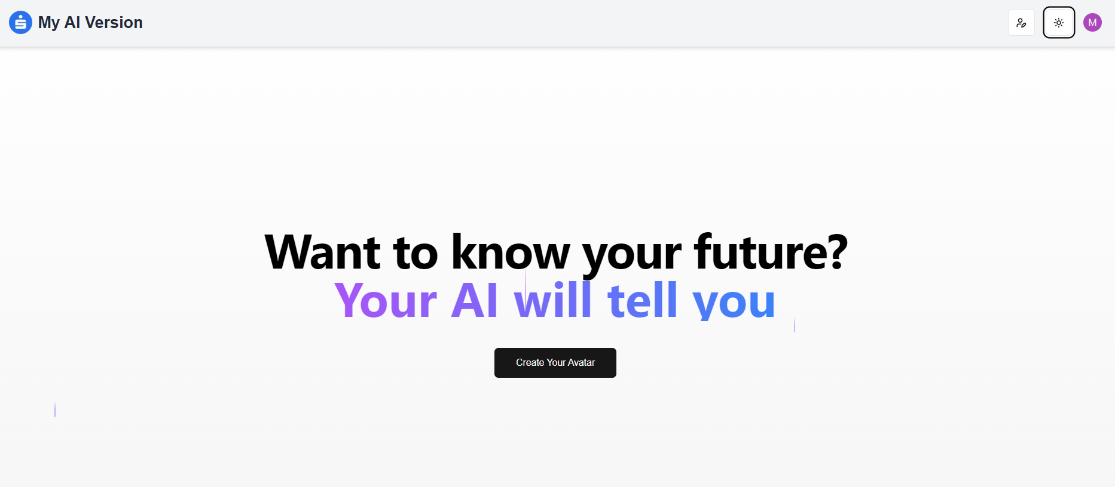
Turn on the lights!

Slide 9
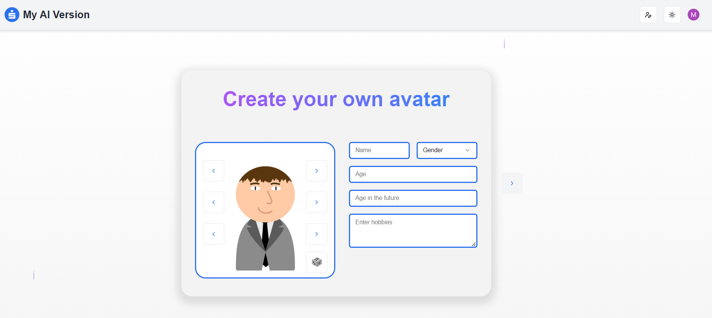
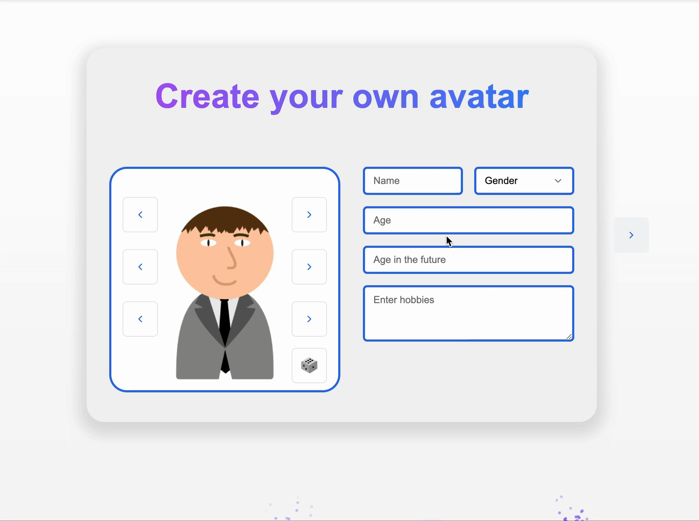
AI Assistant
Avatar customization

Slide 10
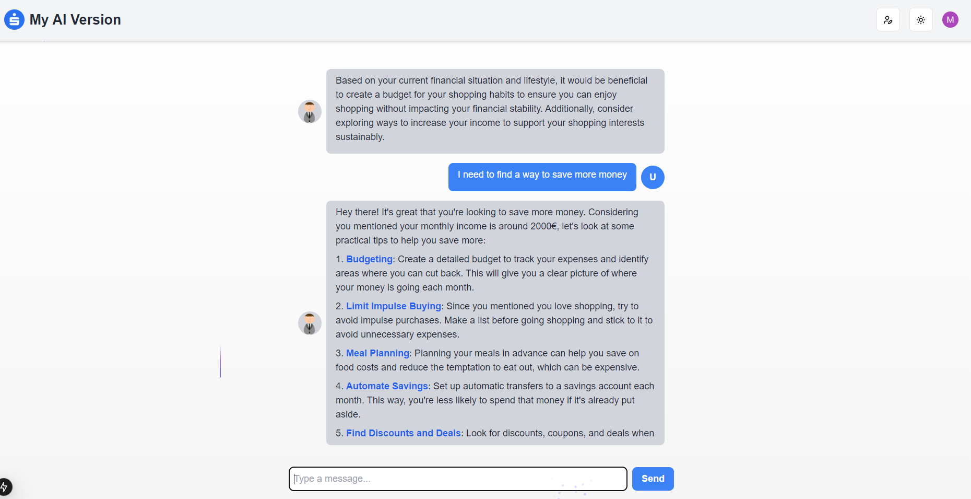
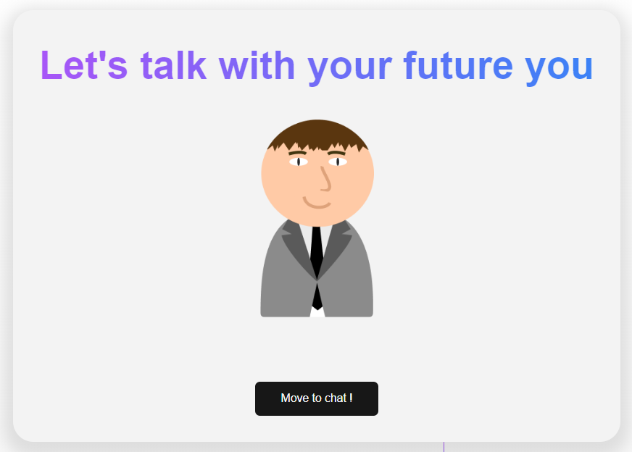
AI Asistent
Chatting

Slide 11
Thank you for your attention.

